Slide 1
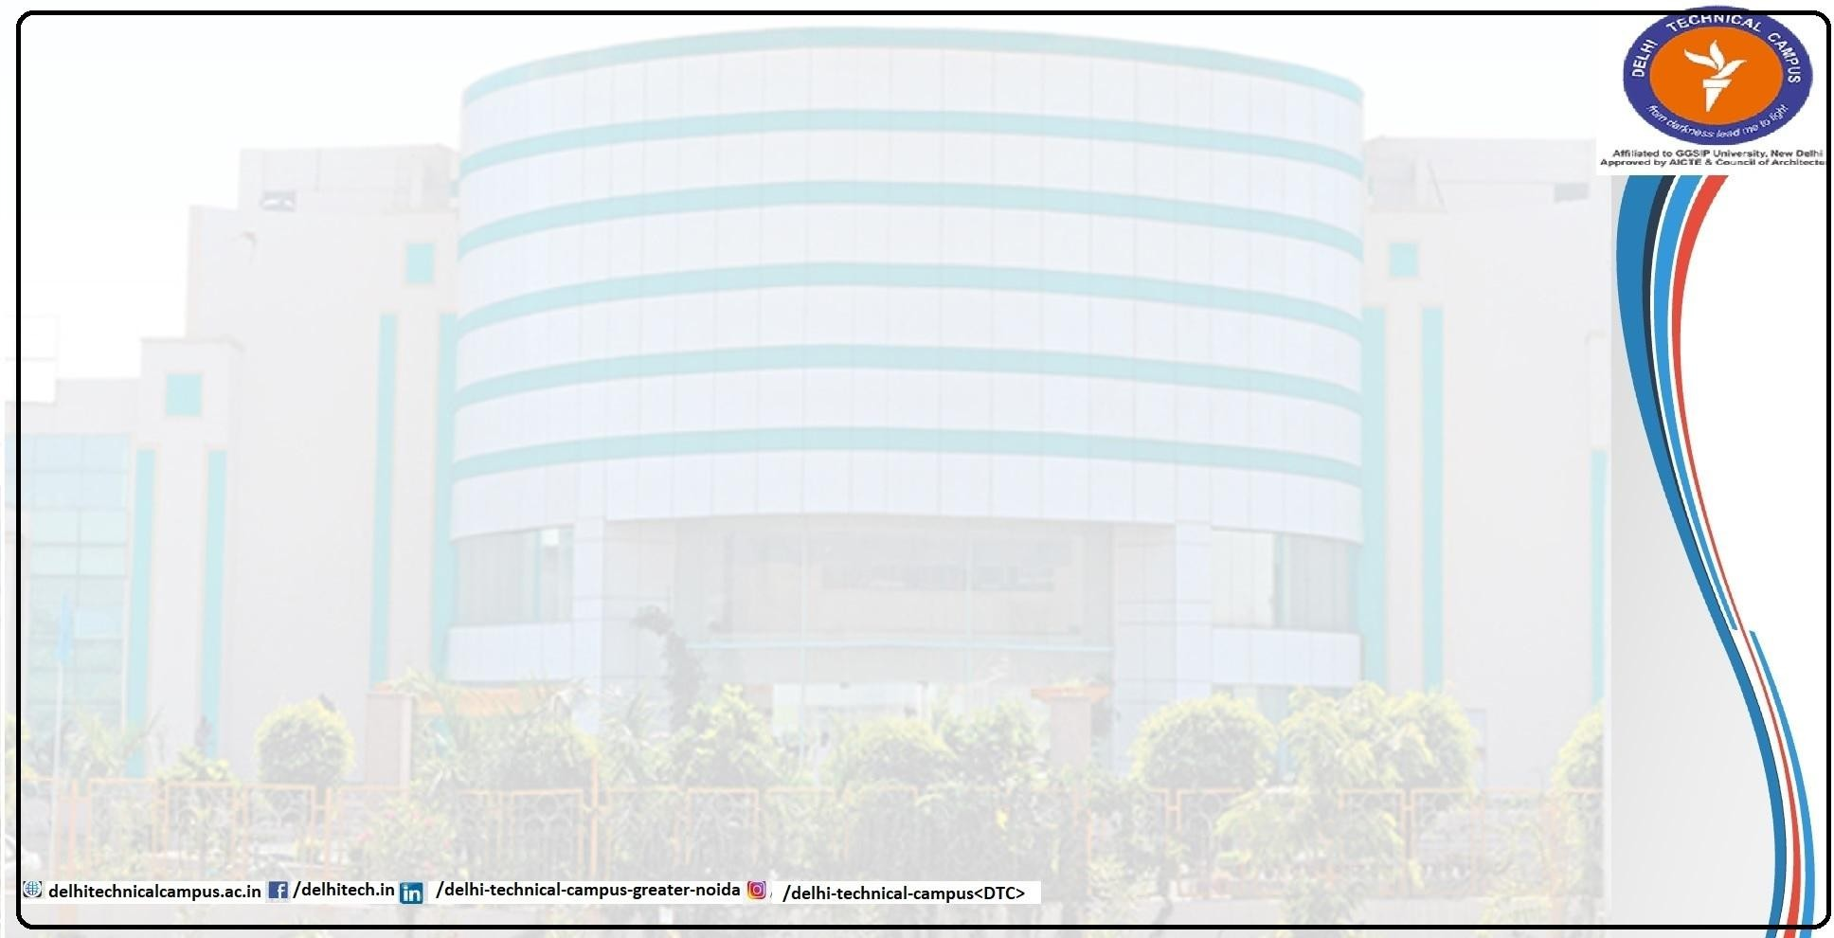
Project Based Learning
ON
A Chess engine
Under Programming in Python
BACHELOR OF TECHNOLOGY
in
COMPUTER SCIENCE & ENGINEERING
AT
DELHI TECHNICAL CAMPUS GREATER NOIDA
Submitted to-
Submitted by-
Name – Mrs. Pridhi Arora
Satyam Mishra ( 03818002722)
Designation – Assistant Professor
Shivam Singh (02618002722) Ayush (03718002722)

Slide 2
Project Overview
We have built a Chess Engine for beginners where users can play chess with ai opponent and learn chess with the liberty to make mistakes. It allows users to:
Play Chess without a physical opponent
Traceback to their previous move
Keep track of all the moves throughout the game
Learn complex moves and get better
The project includes full-stack development from frontend design to backend logic.

Slide 3
Technologies Used
Frontend:
HTML5 & CSS3 for structuring and styling the web pages
JavaScript for user activity
Backend:
Python handles server-side logic and chess engine logic
Other Tools:
Local Server (Flask)

Slide 4
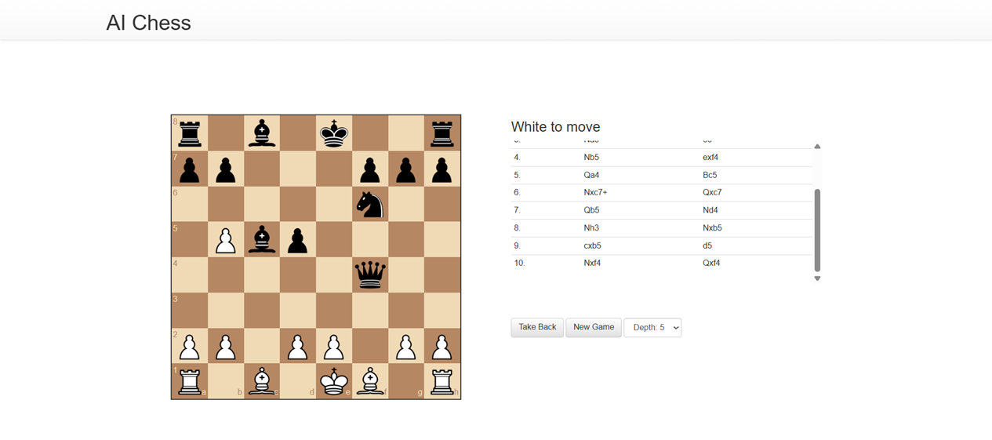

Landing Page
Acts as the homepage with a modern, attractive layout
The engine results in the best possible counter movie
New game button takes user to a new game
Right side keeps a track of all moves
Take-back button leads users to their last move.

Slide 5
Conclusion
Key Takeaways from the Chess engine Project:
The Chess Engine project is an excellent practical application of Artificial Intelligence in a deterministic environment. It successfully combines programming logic with algorithmic thinking to simulate intelligent decision-making.
This project not only deepens understanding of AI concepts like minimax and pruning but also improves software engineering practices through modular and clean code development.
By implementing such a system from scratch, the project helps bridge theoretical knowledge and real-world applications in AI, game development, and problem-solving.

